Slide 1
VIRTUAL INTERNSHIP 7.0
Infosys | Springboard
INTERNSHIP COMPLETION REPORT • BATCH 1 • GROUP 1 • TEAM A
Cyber Threat Analytics Platform with Incident Visualization System
Team Members: Akshay Jaiswal, Darsh Dwivedi, Harini T, Hemanth M
Mentor: Mrs. Nithayasri S J | Duration: 8 Weeks | Year: 2026

Slide 2
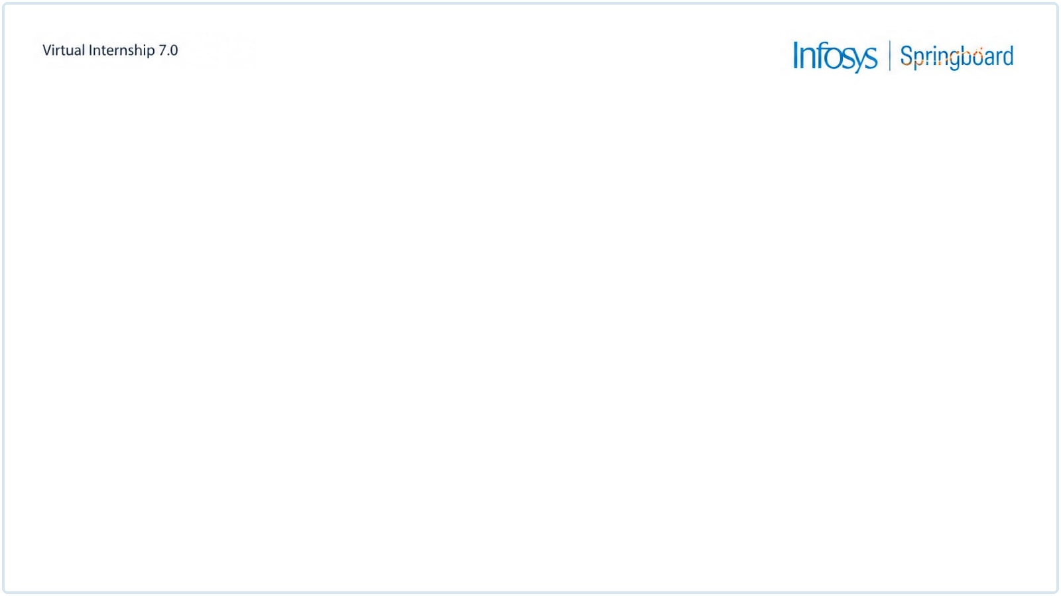









Project Objective
OBJECTIVE
PROJECT MODULES
Analyze real-world cyberattack data to detect patterns of malicious network activity
1. Data Acquisition
2. Data Understanding & Connection
Enable early detection of intrusions and reduce response time to security incidents
3. Data Preprocessing
Transform raw security logs into clear, actionable visual dashboards
4. Threat Analytics & Visualization
Deliver an interactive Power BI dashboard revealing key threat trends and insights
5. Power BI Dashboard Development

Slide 3
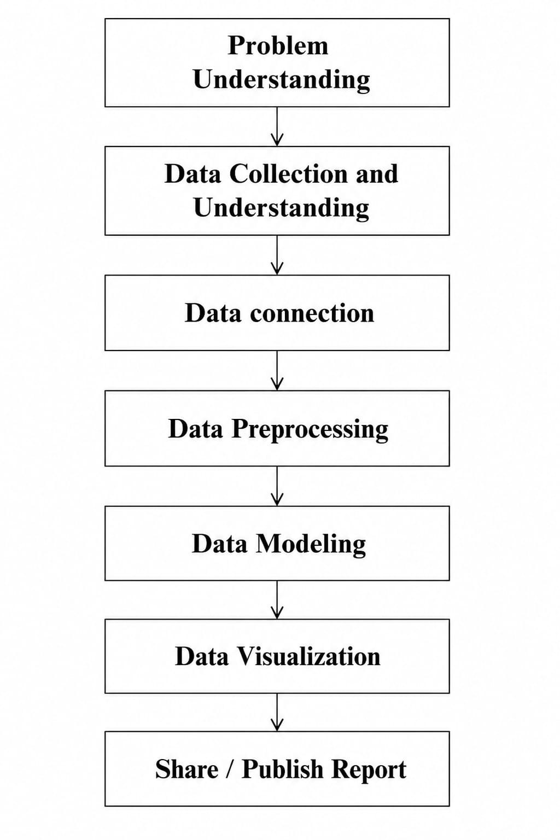

Workflow Diagram

Slide 4



Project Execution Milestones
MILESTONE 1
MILESTONE 2
MILESTONE 3
MILESTONE 4
Data Acquisition & Cleaning
Data Modeling
Development
Review & Optimization
Collected dataset from Kaggle
Studied structure & fields
Prepared raw data for use
Connected dataset in Power BI
Verified data types
Understood key features
Built 12-step preprocessing pipeline
Developed Power BI dashboards
Created threat visualizations
Validated dashboard accuracy
Analyzed threat patterns
Refined key insights

Slide 5
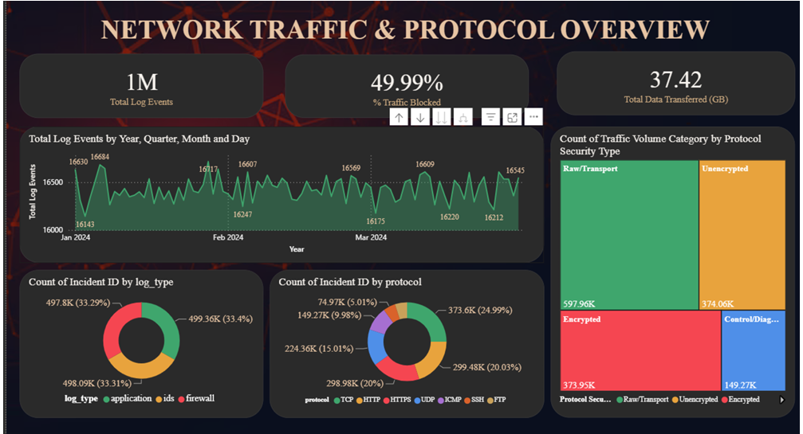
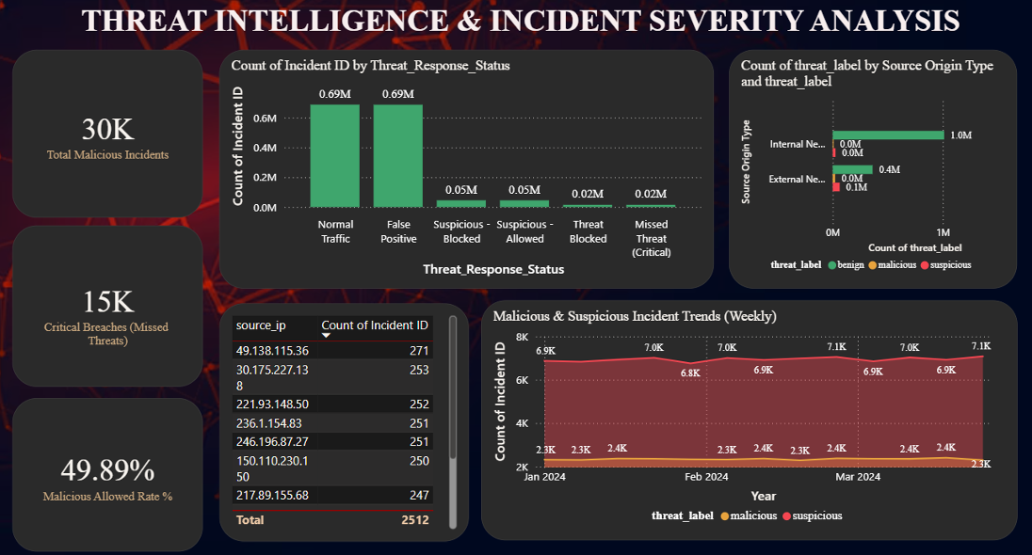
Dashboard-1
Dashboard-2

Slide 6
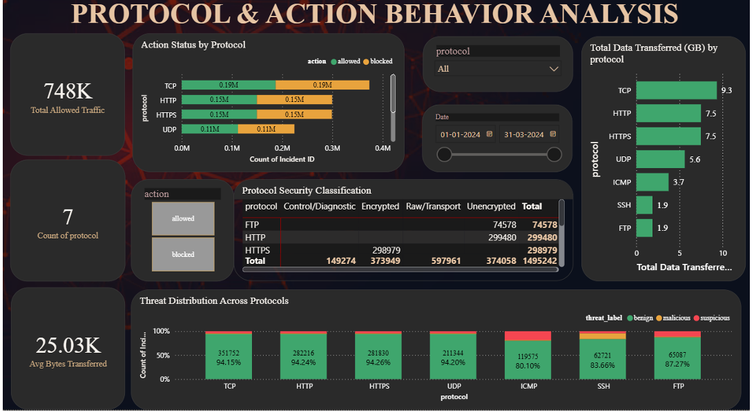
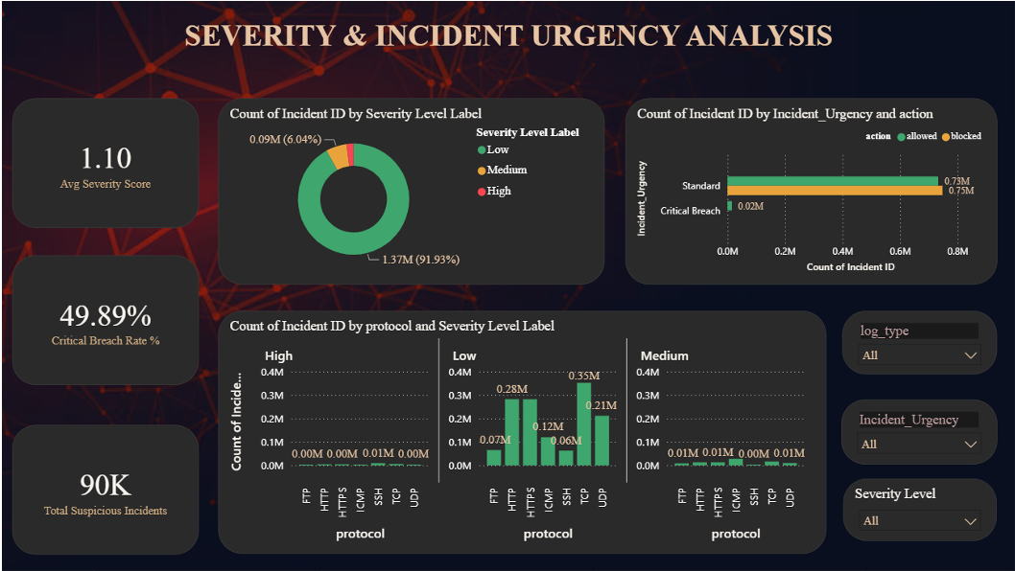
Dashboard-3
Dashboard-4

Slide 7
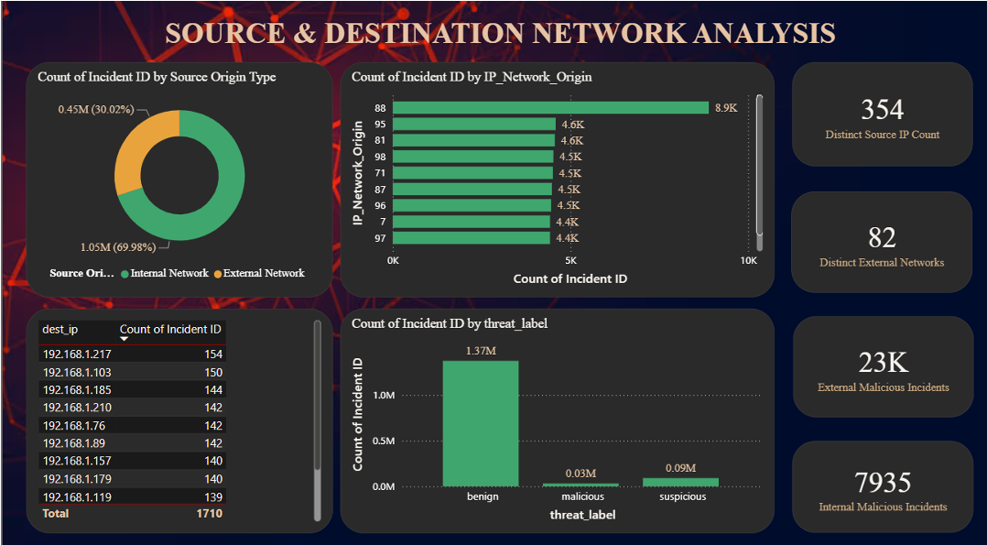
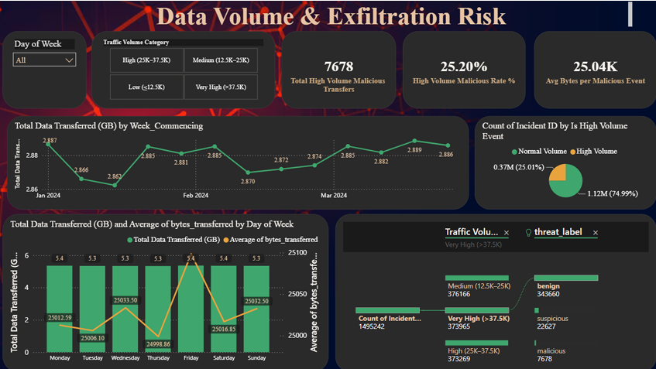
Dashboard-5
Dashboard-6

Slide 8
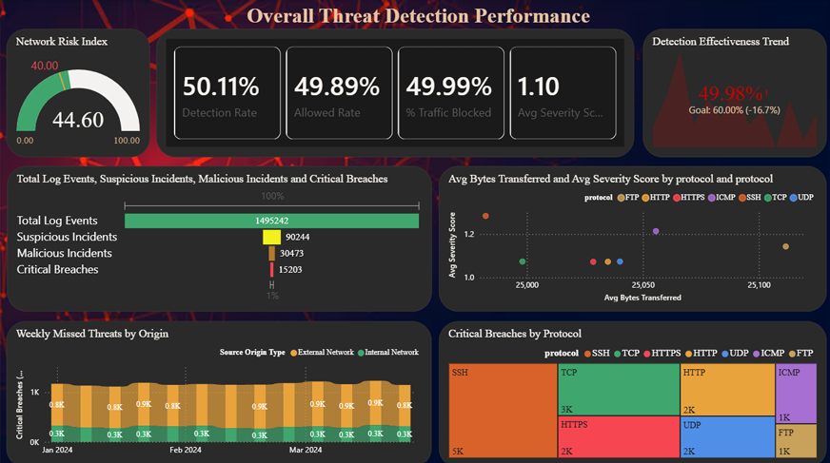
Dashboard-7

Slide 9


Challenges & Resolutions
CHALLENGES
RESOLUTIONS
Large volume of raw cybersecurity data to process
Loaded and processed the cybersecurity dataset using Power BI
Difficulty identifying malicious traffic and meaningful threat patterns
Applied systematic analysis and interactive visualizations to identify patterns
Raw data required cleaning and preprocessing before visualization
Implemented the complete 12-step preprocessing workflow

Slide 10
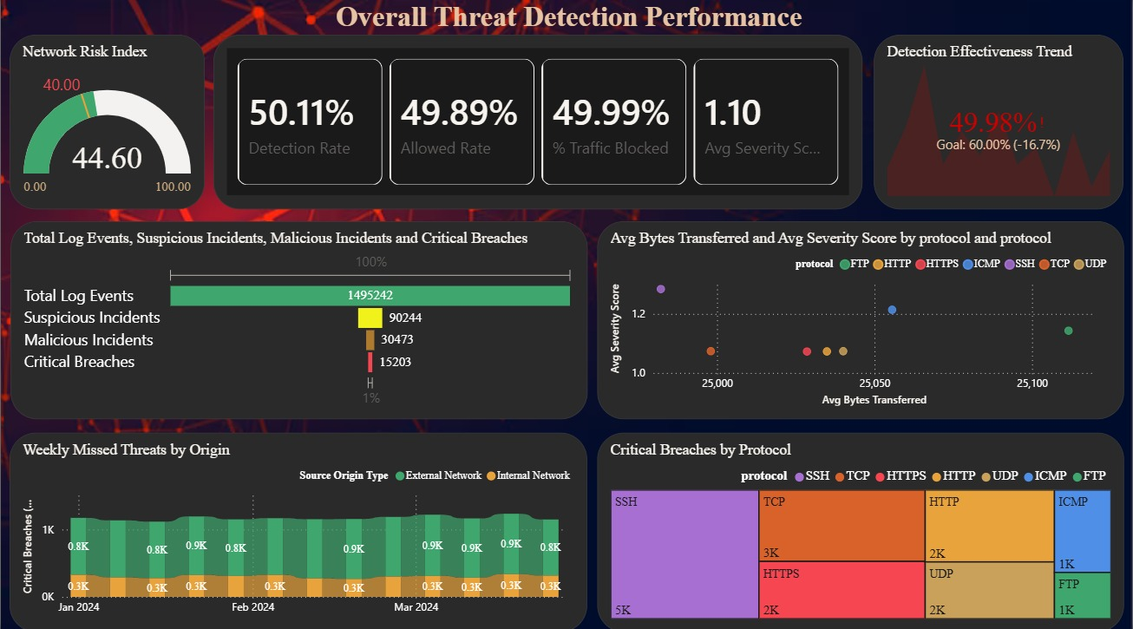



Future Enhancements & Key Insights
FUTURE ENHANCEMENTS
Real-time threat monitoring
Automated threat alerts & notifications
Integration with additional cybersecurity datasets
AI/ML-based threat prediction & anomaly detection
Dashboard 7 of 7 — Overall Threat Detection Performance
KEY INSIGHTS
44.60 Network Risk Index — above the 40 elevated-risk threshold
50.11% detection rate; 49.99% of traffic actively blocked
SSH recorded the highest share of critical breaches

Slide 11
Conclusion
Cyber Threat Analytics Platform with Incident Visualisation System successfully transformed raw cybersecurity threat detection logs into an interactive Power BI-based threat analytics and visualization solution.
TECHNICAL SKILLS
Power BI
Power Query
Data Preprocessing
Data Visualization
Data Analysis
SOFT SKILLS
Problem Solving
Communication
Teamwork
Presentation

Slide 12


Acknowledgements & References
ACKNOWLEDGEMENTS
REFERENCES
Infosys SpringBoard Virtual Internship 7.0
Mentor — Mrs. Nithayasri S J
Team Members — Akshay Jaiswal, Srinidhi, Darsh Dwivedi, Deepan S, Harini T, Hemanth M
Kaggle — Cybersecurity Threat Detection Dataset
Power BI Official Documentation
Power Query Documentation
Infosys Springboard Training & Internship Materials

Slide 13

Thank You

